Slide 1

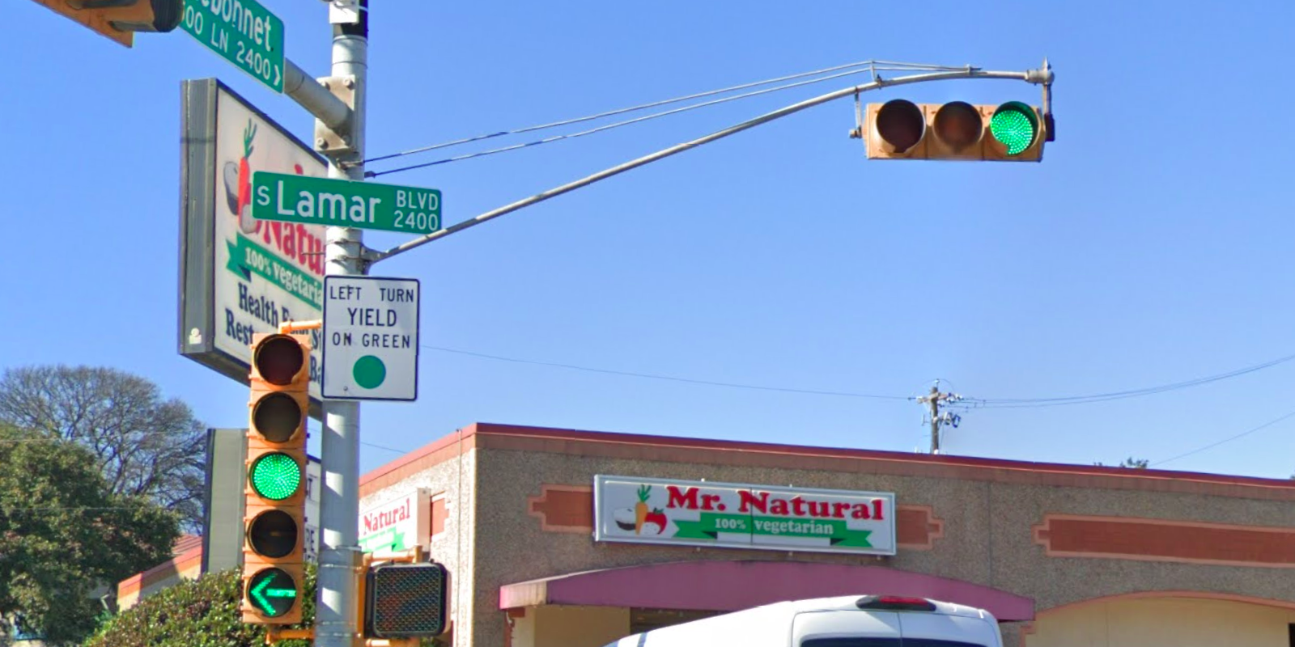
Austin Transportation Department Signs Work Orders
Created By: Susanne Gov Created Date: 2020-08-10 Location Name: LAMAR BLVD / BLUEBONNET LN Intersection ID: 5152555 Cardinal Direction: N
Sign Type | Install/Remove
Left Turn Yield On Green | Install
Street Name Sign | Install

Slide 2
Austin Transportation Department Signs Work Orders
Created By: Susanne Gov Created Date: 2020-08-10 Location Name: LAMAR BLVD / BLUEBONNET LN Intersection ID: 5152555 Cardinal Direction: S
Sign Type | Install/Remove

Slide 3
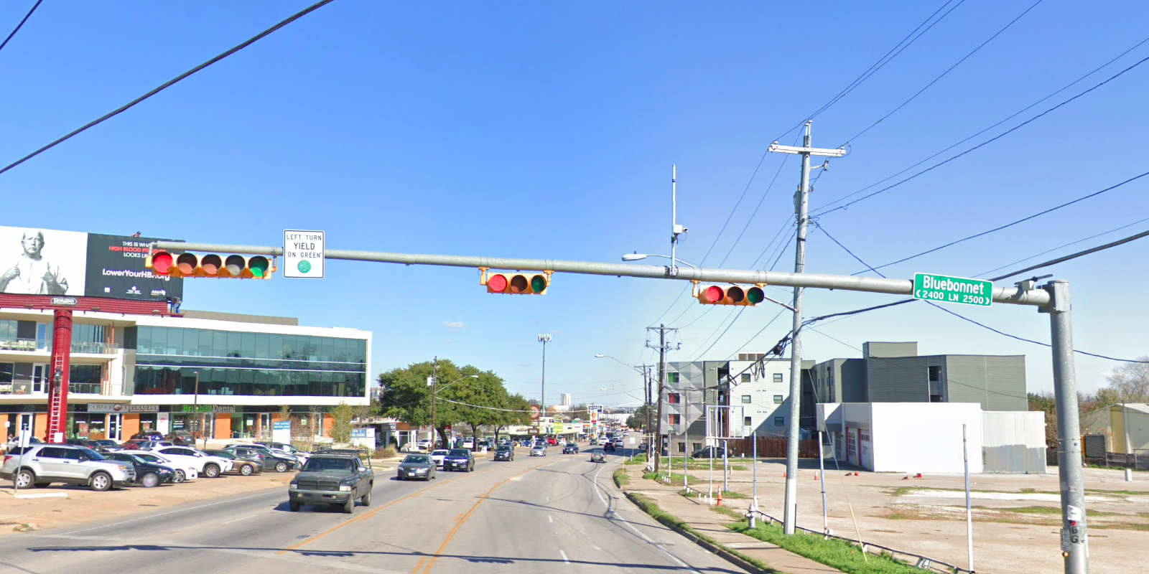
Austin Transportation Department Signs Work Orders
Created By: Susanne Gov Created Date: 2020-08-10 Location Name: LAMAR BLVD / BLUEBONNET LN Intersection ID: 5152555 Cardinal Direction: E
Sign Type | Install/Remove
Left Turn Yield On Green | Install
Street Name Sign | Install

Slide 4
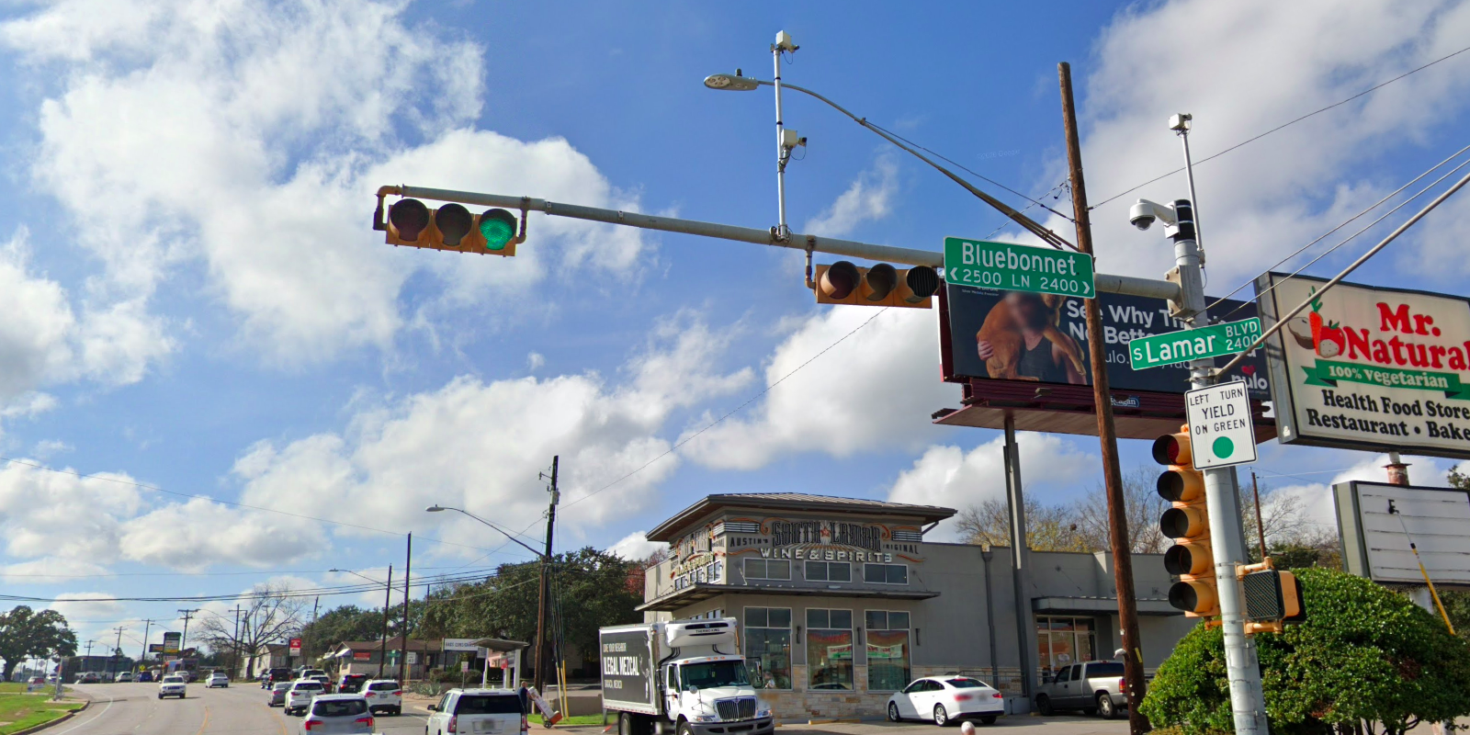
Austin Transportation Department Signs Work Orders
Created By: Susanne Gov Created Date: 2020-08-10 Location Name: LAMAR BLVD / BLUEBONNET LN Intersection ID: 5152555 Cardinal Direction: W
Sign Type | Install/Remove
Left Turn Yield On Green | Install
Street Name Sign | Install

